Slide 1
Air Distribution 101
William Niejadlik
Principal, Niejadlik Management and Consulting

Slide 2
What are we going to talk about?
What it takes to be a travel agency ( in California )
All the systems used to sell air tickets
Focus on the agency and what systems/integrations are necessary
Define a lot of acronyms such as: ATPCO, ARC, IATA, SSIM, CAT35
Answer your questions!

Slide 3
Don’t worry!
You can download this entire presentation at:
http://www.niejadlik.com

Slide 4
About me
Have run my own transportation technology consultancy since 2011
Consulting with agencies, airlines and start-ups
Co-founder and CTO of vayama.com
SVP of Emerging Technology at BCD Travel
Director at Talus Solutions
Senior Consultant at Sabre
Founding member Scheduling Systems Inc.

Slide 5
Let’s start with the basic question… What do you need to sell airline tickets?

Slide 6
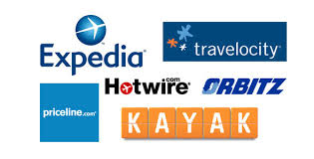
What do you need to sell airline tickets?
Payment
Booking
Fraud
Prices
Ticketing
Content
Changes
Authorization
Reconciliation / Accounting
Traditional
Travel Agent
Your Travel
Application
Big OTA

Slide 7
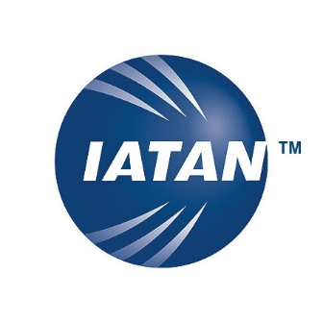
Authorization to Sell
Ever wonder why they are called “travel agents”?
You are literally an “agent” of the airline authorized to sell air tickets.
So, how do you get authorized?
California Seller of Travel
International Airlines Travel
Agent Network
Airlines Reporting
Corporation
Business entity and license
Surety bond (large enough to cover all outstanding customer payments)
Or separate trust account for customer funds
$100 x locations application fee
$235 application fee
Business entity and license
At least one person with 2+ years of experience (QMP)
Proof of Seller of Travel Registration
$ 2300 application fee
Minimum $20,000 surety bond
ARC Specialist Qualifier (AQS)

Slide 8
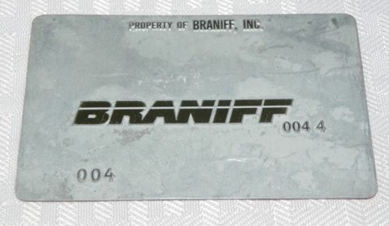
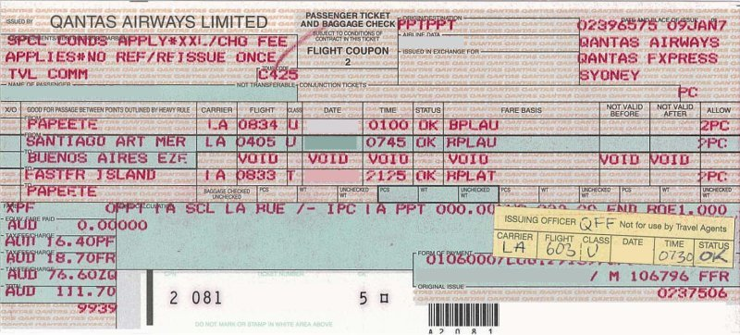
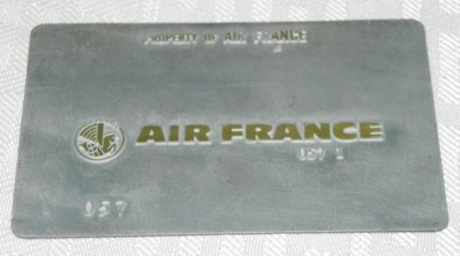
Authorization to Sell
What do you get when you are accredited?
You are authorized to sell air tickets and
validate/plate them on authorized airlines.
What does validate/plate mean?
Every ticket has a “validating carrier”, this
represents the airline which will handle
the payment on behalf of all airlines involved.
The term “Plating” also comes from
These…
Which were used in these…
To make these!

Slide 9
Content

Slide 10
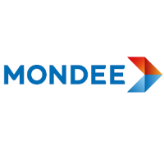
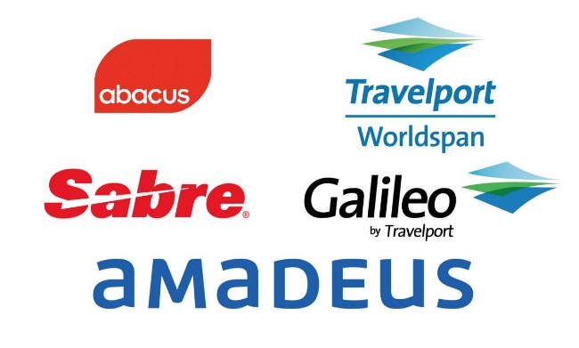
Content
In our context, content = flights… flight schedules, itineraries, O/Ds, etc.
There are quite a few ways of getting content…
Global Distribution Systems (GDS)
The traditional manner of getting air content for agencies
Airline Direct Connects
Aggregators
Partnerships / Affiliate

Slide 11
Content
There are many ways to connect to content and services…
Amadeus web services
(Proprietary)
Sabre SOAP API and REST API
(Based upon OTA standard)
Travelport Universal API
(Proprietary)
Airline Direct Connects
(NDC standard)
Travelfusion XML API
(Proprietary)
Various APIs
(Proprietary)

Slide 12
Prices / Fares

Slide 13
Prices
Fares are distributed to the GDS’s (and others) via a company called:
ATPCO published both initial fares, and subsequent fare changes from the airlines.
GDS’s typical load ATPCO data multiple times a day.
( Airline Tariff Publishing Company )

Slide 14
Prices
Fare Types:
Published: the most common fare, visible to all customers.
Private Fare (CAT 15): A private fare, visible to specified customers only (typically by IATA or office id).
Fare By Rule (CAT 25): A private fare that calculates a discount off another fare.
Negotiated Fare (CAT 35): A private fare that allow markup.

Slide 15
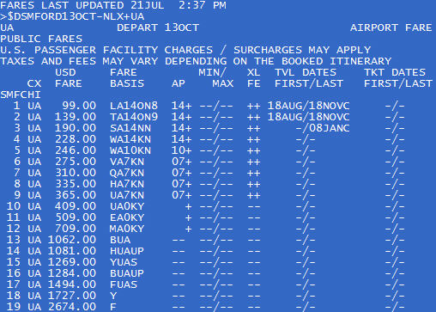
Prices
Fares are typically determined well before operation.
Fares can be O/D based or segment based.
Each O/D may have 50+ fares associated.

Slide 16
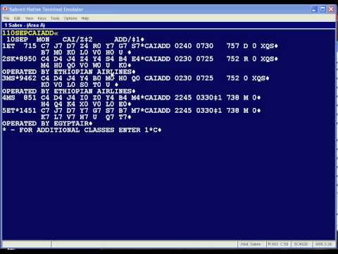
Prices
How do you find the low price?
In the “old days”, an agent would utilize the fare display and availability display to find the lowest prices.

Slide 17
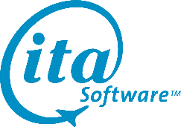
Prices
Today, GDS APIs, direct connects, and aggregators offer shopping engines which evaluate schedule, fare and availability together.
Master Pricer
Extreme Search
Meta Pricer
Bargain Finder Max
Power Shopper
NDC Flight Offer
QPX
One Search

Slide 18
Prices
Do GDS/external shopping engines return private and nego fares?
Yes, with an important caveat.
All engines will return the private / nego fares filed via ATPCO, or loaded using a private fare tool associated with the engine.
However… they may not have the final markup applied.

Slide 19
Prices
Typical OTA Shopping Flow
Shop Pre-processor
Determine number of shops to issue, to whom and shop parameters
Pricing Engine
Apply Markups to CAT35s
Calculate commissions
Post Processor
Filter unwanted results
Group
Sort
Your Booking
System

Slide 20
Prices
Important things to consider when choosing a shopping engine:
How many options does the engine return?
How fast is the shopping engine?
How good is the shopping engine’s availability quality?
Does the GDS have last seat availability agreements on the carriers you most book?
Does the shopping engine have a good bookability ratio?
Does the shopping engine correct itself after booking failures?
Does the shopping engine have advanced features such as calendar search?
Does the shopping engine support fare families and fare bundling?
Can the shopping tool help you with private fare management and pricing?
What is the cost of the shopping engine?
Are there look to book ratios involved?

Slide 21
Booking

Slide 22
Booking
Once you find the flights you like, you need to book...
The “Bookability” of an itinerary is based upon segment / OD availability and airline availability quality
The number represents “numeric”
availability (the number of seats
remaining). Although typically 7 or
9 means many available.
The letter represents the “fare category”,
typically related to the first letter of the
fare.

Slide 23
Booking
To sell an O/D at a particular fare, there has to be availability in the particular fare category for all legs involved…
Selling from one fare category can also reduce inventory in other categories (nested Yield Management).
Availability is CONSTANTLY changing…
The airline has the “master” availability. GDS’s utilize AVS/NAVS and “seamless availability” messaging to constantly retrieve up to date availability.

Slide 24
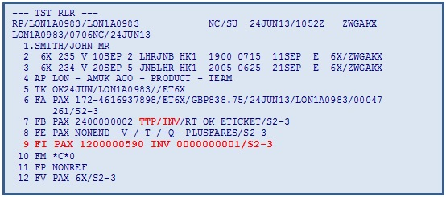
Booking
Once an itinerary is booked (in the GDS) a few things happen…
Flight legs are confirmed and airline inventory decremented
A GDS PNR is created
Airline Locators are
returned
The fare is stored in the PNR
But… this is not ready to fly yet!
We will get back to that later…

Slide 25
Payment

Slide 26
Payment
GDS’s and direct connects utilize the Airline Reporting Corporation (ARC) to help process and reconcile payments.
GDS/ARC Supports two payment options:
Credit / Debit Card
Cash / Check

Slide 27
Payment
Credit / Debit Card:
The card is directly passed through the GDS to the airline.
The airline is the merchant of record.

Slide 28
Payment
Cash / Check:
The airline is paid via “cash” from the agency. The form of payment from the customer could be anything…
The airline is paid during the ARC weekly reconciliation. Funds are debited directly from the agency bank account.

Slide 29
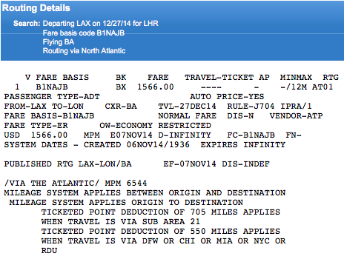
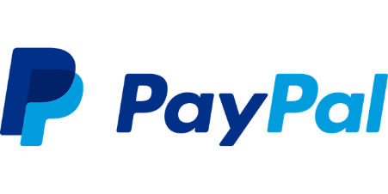
Payment
There are many scenarios where the agency wants to collect directly from the customer and report the sale as CASH to ARC.
Alternative Payment Methods
Packaging / Bundling
Fare Rules / Restrictions

Slide 30
Payment
Most agencies have at least one payment gateway in addition to sending credit cards directly to the airlines.
A warning: Most card processors / gateways consider travel HIGH RISK!

Slide 31
Fraud

Slide 32
Fraud
Do not forget a fraud detection system!!!
If one is included in your payment processor, it may not be enough.
Credit cards passed through to the airline via ARC have VERY LITTLE fraud detection.
You are responsible for ALL fraud on credit cards sent to the airline directly via ARC.

Slide 33
Fraud
Typical fraud routines run on travel transactions:
Blacklists
O/D Risk
Name Analysis
Fraud Cookies /
Machine Id
Geo-IP
Analysis
External Provider
Scoring (e.g. MaxMind)
Transaction
Velocity
Address –
Departure
Analysis
AVS / CVV2
Airport / Country /
Region Risk
3Dsecure
Card Tester

Slide 34
Fraud
But there are some new players that can help mitigate risk:

Slide 35
Ticketing

Slide 36
Ticketing
If you remember our PNR after booking…
I mentioned that it was not ready to fly.

Slide 37
Ticketing
Air Reservations are made up of two important parts:
Reservation
Identified by a PNR Locator
Holds space on exact flights
Traveler names
Ticket
Identified by an airline code and document number
Holds value
Tied to a O/D and route
A reservation is not ready to fly unless it is “ticketed”. Meaning that a valid ticket is attached and aligned with the reservation.

Slide 38
Ticketing
The act of “ticketing”, creates a ticket using the ticket stock of the validating/plating carrier.
Tickets are made up of the airline code and document number

Slide 39
Ticketing
Ticketing also causes:
The sale to be reported to ARC.
The customer’s credit card to be charged (if directly passed).
A GDS invoice to be created and sent to your back office system.
Tickets can be VOIDed within 24 hours.

Slide 40
Changes

Slide 41
Changes
One of my common complaints while running vayama was “why can’t they just fly it the way they booked it”?
Changes aren’t just done by business travelers… everyone does it (or tries)…
Even online agencies can experience 100s of change requests a day.

Slide 42
Changes
To make a change for a customer, the agent (or system) has to make changes in two parts of the reservation:
Reservation
Book new flight segments
Verify fare rules
Cancel old flight segments
Ticket
Calculate any fare changes
Calculate penalties
“Adcollect” additional funds from traveler
Exchange the original ticket for a new ticket.

Slide 43
Changes
Changes are reported to ARC (because of the exchange to new ticket).
The GDS generates new invoices for your back office system.
Changes typically are very manual… But there are some technologies now available to automate exchanges.
Amadeus Ticket Changer
Automated Exchanges
Rapid Reprice

Slide 44
Reconciliation / Accounting

Slide 45
Reconciliation / Accounting
Everyone’s favorite subject when it comes to travel distribution! Also the most forgotten.
Reconciliation is the analysis necessary to determine if what you think you sold matches the airline’s record of what you sold.
It is used to catch mistakes in fare calculation, fare rules and exchanges. Which are not uncommon… (even with technology)

Slide 46
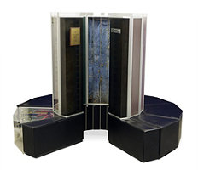
Reconciliation / Accounting
The reconciliation “circle of life”…
Sale Reports
Weekly Report
IAR
IR Records
BOS File
Adjustments
Agency Backoffice
System

Slide 47
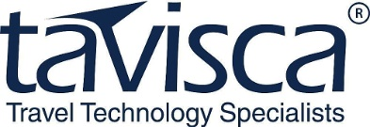
Reconciliation / Accounting
There are a number of major players in agency back office systems:
TRAMS
Amadeus Agency
Manager

Slide 48
Reconciliation / Accounting
Debit and Credit Memos:
Debit memos are sent by airlines to collect additional moneys due to alleged agent errors.
You are “guilty until proven innocent”.
All airline fraud loss charges are passed back to the agent via debit memos.
Airlines have large auditing teams and software looking for errors.
Failing to pay debit memos results in loss of your airline plate.

Slide 49
Recap
So what do I need to sell airline tickets?
Authorization
IATA or other way?
Content
GDS? Direct Connect?
Prices
Shopping Engine? Private
Fares?
Booking
Availability quality…
Payment
Payment Gateway choice?
Fraud
Fraud Detection Strategy?
Ticketing
High volume or low?
Changes
Do changes? Automation?
Reconciliation / Accounting
Back office choice? Debit
Memos

Slide 50
Questions?
William Niejadlik
Travel Technology Consultant
http://www.niejadlik.com

